Slide 1
LESSON 7.1
Primary & Secondary Cells

Slide 2
LESSON GOALS
I can explain how a redox reaction is used to produce electricity in a primary (voltaic) cell
I can explain the direction of electron flow from anode to cathode in the external circuit, and ion movement across the salt bridge in a primary (voltaic) cell
I can deduce the reactions of the charging process from given electrode reactions for discharge, and vice versa
I can discuss the advantages and disadvantages of primary cells and secondary cells

Slide 3
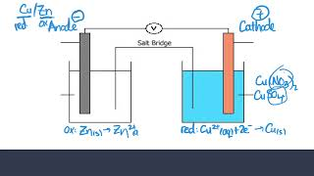
TASK 1: LEARN (MUST DO)
Individually or with a partner:
Watch the Voltaic Cells video
Complete the appropriate section of the guided note
Note: Primary Cells = Voltaic Cells = Galvanic Cells (all used interchangeably)

Slide 4
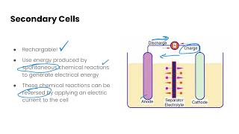
TASK 2: LEARN (MUST DO)
Individually or with a partner:
Watch the Secondary Cells video
Complete the appropriate section of the guided note

Slide 5
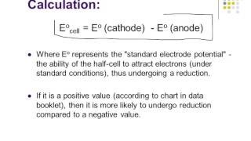
TASK 3: LEARN (MUST DO)
Individually or with a partner:
Watch the Standard Cell Potentials video
Complete the appropriate section of the Guided Note

Slide 6
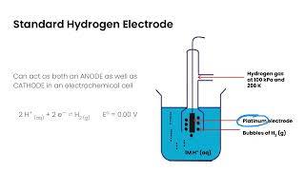
TASK 4: LEARN (MUST DO)
Individually or with a partner:
Watch the Standard Hydrogen Electrode video
Take some notes for yourself!

Slide 7
TASK 5: PRACTICE
Complete the primary & secondary cells practice (answers included)
Note: There are must do, should do, and aspire to do questions included in this practice!

Slide 8
TASK 6: MASTERY CHECK (MUST DO)
Individually:
Complete the Primary & Secondary Cells Mastery Check (see me when you are ready!)

